Slide 1
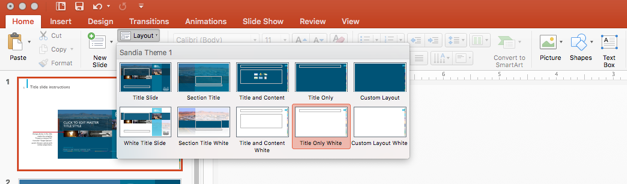
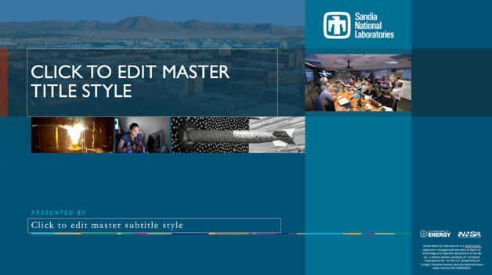
TITLE SLIDE INSTRUCTIONS
Contact Creative Services at 844-7167 for help
Choose from dark and white background layout options from the “Layout” tab in the menu bar
Title font: Gill Sans MT
Change photos in the slide master by using the ”Picture or texture Fill” from the “Shape Options” panel. Choose a photo with similar proportions.
Additional program/partner logos can be added here
Body text/ support font: Garamond MT
Add Sand Number to the funding statement within the Master Title slide

Slide 5

SLIDE DESIGN SAMPLES ON DARK BACKGROUND

Slide 9

SLIDE DESIGN SAMPLES ON WHITE BACKGROUND

